Slide 2
Why are we here?
“In almost every case of domestic homicide, we found that the people around the victim knew what was going on – but didn’t know what to do about it…”
Al O’Marra (Former) Chief Counsel Coroner’s Office of Ontario

Slide 3
What is Domestic Violence?
Domestic violence is a pattern of behaviour used by one person to gain power and control over another with whom he/she has or has had and intimate relationship.
Occupational Health and Safety Council of Ontario (OHSCO)

Slide 4
Gender Differences
According to police, men (49%) and women (51%)
in Canada are equally at risk of violent victimization.
Stats Canada 2008
1999 General Social Survey - 8% of women and 7% of men reported at least one incident of domestic violence.
Stats Canada
…but prevalence rates do not tell the whole story.
Notes:
Gender Differences in Police-Reported Violent Crime in Canada 2008, Roxan Vaillancourt, Canadian Centre for Justice Statistics, Statistics Canada, page 5.
Family Violence in Canada, a Statistical Profile 2000 notes that eight percent of women and seven percent of men "experienced some type of violence by a partner during the previous 5 years“
1999 General Social Survey on Victimization (GSS), this national study found that eight percent of 14,269 women and seven percent of 11,607 men reported at least one incident of intimate partner violence committed by a current or ex-spouse between 1994 and 1999 (Statistics Canada, 2002).

Slide 5
Types of Domestic Violence
Male
Dominant
Coercive Control
Situational
Aggressive
High
Gender
Proportions
Risk
Equivalent
Lower
(Johnson et al., 2002; LaVioilette, 2005; Martin et al., 2006)
Notes:
This chart tells an important part of the story. At the wide base you see the most common form of dv that is “situational”. On the left you can see the “gender proportions” arrow that indicates men & women engage in situations of violence relatively equally… This kind of violence happens when the couple is responding to something in the situation – and do so using violence of some kind. As the level of aggression increases, you can see that the gender proportion shifts up to male dominated violence. The “risk” arrow to the right tells you that as the aggression increases, so too does the risk.
Violence exists on a continuum. At the top of triangle is “coercive control”. Remember that coercive control is not about responding to a situation – the purpose of this form of violence is to dominate; create fear and psychological dependence. It should also be noted that even at the base of triangle where the violence is ‘equally’ perpetrated by men and women, women experience the most serious injuries and are more likely to be hospitalized.

Slide 6
A Continuum of Risk
Coercive Control
Ongoing pattern of violence
RISK
Repeat violence
Violent incident
6

Slide 7
A Continuum of Risk
Coercive Control
Violence may be physical or non-physical. Sometimes abusive partners only use
non-physical forms of violence to maintain their control.
Ongoing pattern of violence
RISK
Repeat violence
Violent incident
7

Slide 8
  Focus on coercive control
Abusive partner uses violence as a tactic to control and coerce
Woman Abuse
There are men who experience coercive control. They also need to be supported and encouraged to seek help.
Domestic violence also occurs in same sex relationships.
Notes:
NFF specifically addresses coercive control and because it is almost always women who are victims, for this reason, we refer to it as woman abuse. Men do experience coercive control but there is less known about their experiences because their situations do not come to the attention of police, require hospitalization or end in murder to the same degree as women. Research is needed to better understand men’s experience of coercive control and how it differs from, or is similar to women.

Slide 9
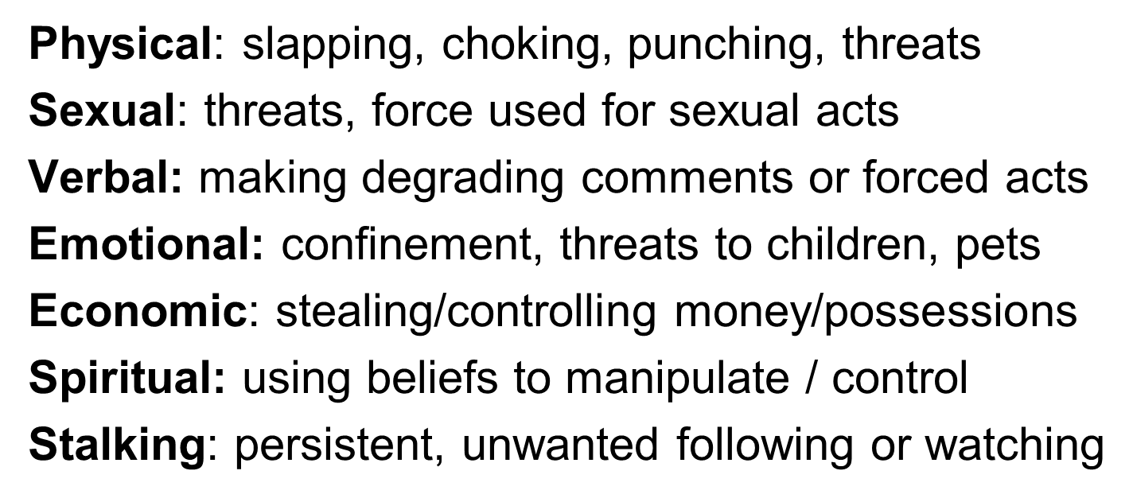
What Does Woman Abuse Look Like?
Notes:
To understand woman abuse, we have to look beyond the behaviours to the motivation. The motivation is to gain power and control over another person. Often someone using abusive behaviour will only use as much force as they have to in order to maintain their control. They can do this through threats or warnings. Many women have described, “the look,” a warning look that lets her know she had better not step out of line.

Slide 10
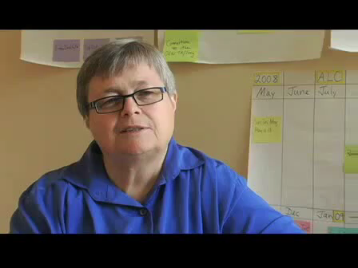
Ellen Pence

Slide 11
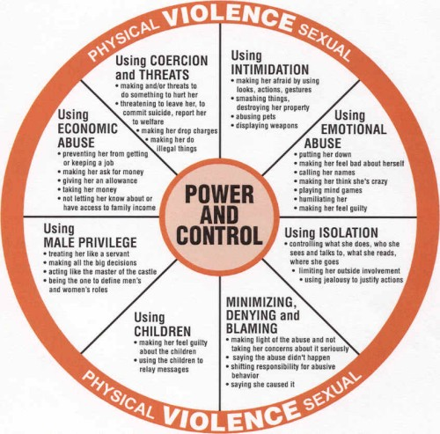
Notes:
Ellen Pence, who spent her life working to end violence against women, helped to develop a graphic representation of how the behaviours of domestic violence hold together the relationship of power and control in a relationship.
Trainer Tip: Show the power & control wheel slide (take out the copy in their package)…How did they do at identifying the major kinds of abuse? Don’t go into a lot of detail…just ask them to check to see how they did at identifying the major categories of abuse. The wheel captures the experience of 20,000 victims of abuse.
Ellen Pence - a bit of history about here…Let’s hear her talk about how the Power & Control wheel was created….
(Insert Ellen Pence youtube clip) http://www.youtube.com/watch?feature=player_embedded&v=r9dZOgr78eE
Ask if any questions about the types of abuse, p&c wheel?
Going to show you a video clip of a scenario in a second…Give (brief) history of Missed Opportunities campaign. As watch the video, watch for all the types of abuse you see referenced or inferred in this scenario. Feel free to refer to the P & C Wheel as do so.
Show Missed Opportunities scene 2
Stand up, find someone from another table…the 2 of you exchange notes about what types of abuse were referenced. Give 2- 4 minutes (or when energy lags)…ask them to return to their tables & sit down. Any Questions?
We would say this scenario is a good example of coercive control….What stands out for you about coercive control as you experienced it in this clip?

Slide 12
Why Focus on Woman Abuse?
  Highest risk cases (Death Review Committees)
  Most serious injuries (Stats Can)
  Preventable (because predictable)
  Lifelong impact on children
  Can’t change what you can’t name
Notes:
The first three points are taken from research into domestic homicides in Ontario.
Impact on children:
There is evidence that children who grow up in the home environment of coercive control are much more likely to become abusers or be abused themselves. Also witnessing domestic violence can cause neurological damage to a developing brain. Behind Closed Doors: The Impact of Domestic Violence on Children, Joint report by UNICEF, The Body Shop International, and the Secretariat for the United Nations Secretary-General’s Study on Violence Against Children, 2006, p.
The last point is a comment. If we call this systematic pattern of violence “domestic violence” or “family violence” the fact that the victims are most often women and children is hidden. We can’t change what we don’t understand. Naming the issue is an important development in changing the culture.
This is a critical factor that led the organizers to be so specific about the type of violence they want to address with the campaign.

Slide 13
Women at Greater Risk
Aboriginal women
  5 - 7 times more likely to be killed
  582 missing/murdered women in Canada
Women with disabilities (15.5% of pop)
  60% experience some form of violence
Young women (16 – 24)
  66% of all female victims of sexual assault are under 24 / 11% are under the age of 11
Notes:
http://www.cdnwomen.org/EN/section05/3_5_1_1-violence_facts.html
Canadian Women’s Foundation

Slide 14
Women at Greater Risk
Immigrant women
  Do not experience higher rates but may be more vulnerable due to economic dependence, language barriers, lack of knowledge of community services
Women in Rural Communities
  Isolation, lack of transportation, long response time for police, firearms in the home, responsibilities for livestock
Notes:
Canadian Women’s Foundation

Slide 15
Purpose of the Campaign
Raise awareness of the signs of woman abuse
Give people who are close to an at-risk woman or abusive man information & skills
  to offer support
  make appropriate referrals

Slide 16
What Do I Need to Know?
  How can I identify women at risk of abuse?
  What are the warning signs?
  What are the signs of high risk?
  How can I talk about the warning signs?
  What safety planning tips can I keep in mind?
  Where can I refer a woman at risk of abuse?

Slide 17
Warning Signs
He puts her down
He does all the talking and dominates the conversation
He checks up on her all the time, even at work
He tries to suggest he is the victim and even acts depressed
He tries to keep her away from you
He acts as if he owns her
He lies to make himself look good or exaggerates his good qualities
He acts like he is superior and of more value than others in his home
Notes:
Often a woman who is experiencing abuse will not tell you directly what is happening. But you might notice warning signs that make you wonder what is going on. The Neighbours, Friends and Families Expert Panel put together this list of warning signs to help you identify situations that may be abusive. If you suspect abuse, it is important to ask questions and not jump to conclusions. These signs do not automatically mean a person is experiencing abuse. They are red flags that tell us that something is not right.
Please take the time to read through these warning signs.
Facilitator Note: Make the point that this is not a comprehensive list nor a definitive list. Ask people to take out the purple brochures from their package (give them time to do that) and turn to the section that lists the warning signs. Give them a few minutes to look this over.
Consider asking…How can this list be helpful to you as a friend, family member, neighbour or co-worker. Take a few comments (3 is good: do not add to them, just let them be said) and then…
Make the point that, even if you think you know someone who may be being abused based on this list, it does not mean that they are in an abusive relationship. We encourage you to use this list to start asking questions and pay more attention: we’ll talk about that a bit more later on in this presentation. For now – try to see the list as a starting point. At the same time, helping to prevent death from this type of violence requires that you be familiar with these warning signs.

Slide 18
Warning Signs
She is apologetic and makes excuses for his behaviour or becomes aggressive and angry
She is nervous about talking when he’s there
She seems to be sick more often and misses work
She tries to cover her bruises
She makes excuses at the last minute about why she can’t meet you or she tries to avoid you on the street.
She seems sad, lonely, withdrawn and is afraid
She uses more drugs or alcohol to cope

Slide 19
Signs of High Risk
He has access to her and her children
He has access to weapons
He has a history of abuse with her or others
He has threatened to harm or kill her if she leaves him: He says “If I can’t have you, no one will.”
He threatens to harm her children, her pets or her property
He has threatened to kill himself
He has hit her, choked her
He is going through major life changes (e.g. job, separation, depression)
Notes:
Just as experts have been able to identify warning signs, they have also been able to identify signs that a situation is high risk. The Neighbours, Friends and Families Expert Panel identified this list of high risk signs. If a man is behaving abusively and these high risk signs are present, there is a greater danger that he will do something to seriously harm or even kill his partner or ex-partner.
Please take the time to read through these signs of high risk. You can download a copy of this list of signs of high risk here. [will give you the address]

Slide 20
Signs of High Risk
He is convinced she is seeing someone else
He blames her for ruining his life
He doesn’t seek support
He watches her actions, listens to her telephone conversations, reads her email, follows her
He has trouble keeping a job
He takes drugs or drinks every day
He has no respect for the law

Slide 21
Signs of High Risk
She has just separated or is planning to leave
She fears for her life and for her children’s safety or she cannot see her risk
She is in a custody battle, or has children from a previous relationship
She is involved in another relationship
She has unexplained injuries
She has no access to a phone
Notes:
Some of the signs of high risk relate to a woman’s vulnerability. If a woman is experiencing abuse and any of these signs of high risk are present, she is more likely to be seriously harmed or even killed.
Please take the time to read through these signs of high risk. You can download a copy of this list of signs of high risk here. [will give you the address]

Slide 22
Signs of High Risk
She faces other obstacles (e.g. she does not speak English, is not yet a legal resident of Canada, lives in a remote area)
She has no friends or family

Slide 23
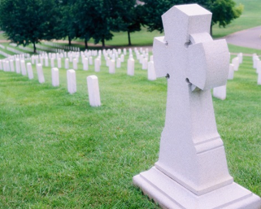
When Women are Killed
  A history of domestic violence
  Actual or pending separation
  Obsessive behaviour
  Depression of the perpetrator
  The level of violence is increasing
  Prior threats / attempts of suicide
  Threat to kill
  Prior attempts to isolate victim
  Victim had intuitive sense of fear
  Perpetrator unemployed
Notes:
The Domestic Violence Death Review Committee has found that in almost 80% of the cases where a woman was killed 7 or more risk factors were present. This means that generally, there are many signs pointing to the fact that risk is escalating in a situation. If we are aware of these signs, we can let the woman at risk of serious harm or even death know about her risk. This will enable her to take additional steps to ensure her safety and the safety of children.
The list here shows the most common risk factors in the cases reviewed by the Domestic Violence Death Review Committee.

Slide 24
Frequency of Common Risk Factors
In 76% of the cases reviewed, 7 or more risk factors were identified
In 13% of the cases reviewed, 4 to 6 risk factors were identified
The combined proportion of cases with 4 or more risk factors was 89%

Slide 25
Documentary
“What everyone should know about woman abuse.”
Lived Experience
Notes:
Information about the video -The video was produced by the London Coordinating Committee to End Woman Abuse.
Warn people about the content – that it is upsetting and difficult – the story of Sandra Schott who was murdered by her husband, from whom she was separated, in Ingersol in August 2005.

Slide 26


Slide 27
What Warning Signs Did You See?
What High Risk Factors were Present?
Notes:
Ask participants to use the purple brochure to identify warning signs and risk factors that appeared in the video.

Slide 28
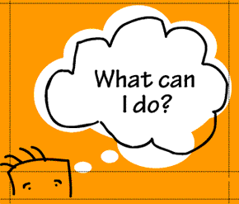
I’m a neighbour, friend, family member…

Slide 29
The Power of Isolation
Isolation is a always present in abusive relationships…
It could even be considered a necessary condition for abuse to occur
Notes:
In any abusive situation – isolation is a key factor. Isolation of the victim, the abuser, the children and the friends and family members. As the situation gets worse, as it inevitably does without some kind of intervention, the isolation intensifies, people become more and more alone and often the abuse escalates.

Slide 30
Behaviours Designed to Interrupt Isolation
The Takeaway: a SNCit Conversation
See it…
Name it…
Check it…
Notes:
This is the takeaway – See it – Name it – Check it
What’s the “it” we need to see? (Warning signs, risk factors)
Let’s take these one by one….
30

Slide 31
See it
“That’s not right...
it makes me uncomfortable”
Learn the warning signs
Pay attention to the people around you
Treat your suspicions and concerns seriously
Notes:
If you see a warning sign – it is like seeing the tip of an iceburg, there is likely much more abusive behaviour going on - that you may never see. That’s why it is so important to take the warning signs seriously.
31

Slide 32
Name it
“I am worried about you…I heard him yelling at you again…”
Name your concern:
  to yourself
  to another
Just the FACTS (what did you see?)

Slide 33
Check it
“Are you okay? Do you want to talk?”
Check your assumptions
Use the materials to talk about warning signs
Just talk about what you’ve seen
Ask an expert about what action to take
Call 911 / police in an emergency

Slide 34
Start with Heart
Your genuine concern is the key that will open the door for support

Slide 35
Let’s Practice
Notes:
Watch this short video clip and look for any warning signs or signs of high risk.

Slide 36
Practice - SEE it / NAME it / CHECK it
SNCit:
Name what you see / name your concern:
I saw your ex following you to the grocery store again. I was worried.
Check it:
Are you ok? Do you want to talk about it?
…and STOP!
It is up to her what will happen next
Notes:
Note that the SNCit conversation will happen later, when the woman is alone, not with her partner – for safety.

Slide 37
See it / Name it / Check it - SNCit!
Let’s Practice
No more than 3-4 statements
STOP! after you deliver your lines
You want to open the door for support
  NOT a role play
A chance to practice the skill of
  See it/ Name it/ Check it

Slide 38
Let’s Practice
See it / Name it / Check it - SNCit!
Turn to the person next to you
  One of you is the woman in the supermarket
  One of you is the neighbour
Have a SNCit conversation
  Name your concern
  Check if she is okay
Reverse roles, do the same thing
Go!
Notes:
This is intended to be a quick practice just to give participants a chance to SNCit with a partner. They need only deliver their lines and then STOP, it is not a role play. You want them to stop and check whether they were able to deliver the lines in a genuine way so that the person they are speaking to actually believes they are concerned. In a real situation, you stop after SNCit because the decision about what comes next should shift to the person you are speaking to, concerned about.

Slide 39
Why Doesn’t She Leave?
Understanding the Traps:
History of abuse – grew up in abusive home
Afraid to be on her own
Blames herself for the abuse
Economic uncertainty - poverty
She loves him – believes he can change
She doesn’t want to move the children
Pressure from her family / cultural norms
Notes:
Unless you have lived in an abusive situation, you may ask ‘why doesn’t she just leave?’ When we ask that question – we are blaming her for what is happening. It is not her fault and it is not supportive to push her to do something that we want. And, there are many reasons why she stays. We can at least try to understand some of the traps or thinking that may keep her there. It must be her decision to leave – remember that she is most at risk when she is planning to leave or has left the relationship. The challenge for people who care about her is to find meaningful ways to support her that keep the door to help open.

Slide 40

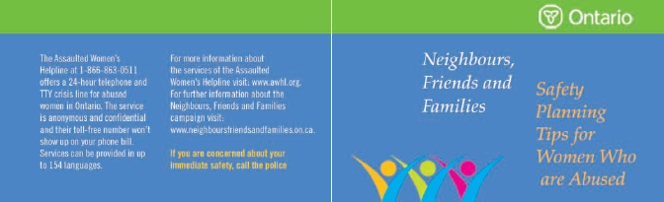
Safety Planning
The goal is not to get her to leave – it’s safety!
Staying in the Relationship
Getting Ready to Leave
Leaving the Abuser
After Leaving
Notes:
There are professionals in your community who will help with safety planning – you can find them by calling the Assaulted Women’s Helpline or by finding your local contacts (e.g., the local shelter, police and many, many websites).
But you should also understand the basics of safety planning. Get to know the brochure: what are the safety considerations you need to know if someone you know is being abused.

Slide 41

What Can I Say?
Someone I care about is acting abusively
Approach him when he is calm
Tell him that you are concerned for him
Recognize that confrontational, argumentative approaches may make the situation worse and put her at higher risk
Notes:
Talking to abusive men is another innovative element in the NFF campaign. It is important to understand that the campaign is not advocating for you to confront abusive men, or to challenge people you don’t know.
This brochure is intended to support the people who care about a person who is acting abusively. If your brother, your best friend or an uncle were behaving abusively toward his partner, you might be the best person to have the conversation and suggest he gets help.
This brochure will give you ideas about how to do that. It is important not to take a confrontational attitude – which may be understandable, but rarely effective. We know that without some kind of intervention, abusive behaviour is likely to escalate. Figuring out how to intervene safely and effectively is the challenge.
Call the helpline first if you find yourself in a situation where you want to talk to someone you believe is acting abusively – don’t be afraid to get help yourself.
A good book that explores the reality of abusive men is written by Lundy Bancroft – Why Does He Do That? Inside the Minds of Angry and Controlling Men. Bancroft has worked with over 2000 abusive men in a PAR program.

Slide 42
Local Resources
24 Hour Crisis Line
The Assaulted Women's Helpline
Crisis Line where help is available 24 hours a day, 7 days a week, every day of the year:
Greater Toronto Area: 416-863-0511
Toll Free: 1-866-863-0511
TTY: 1-866-863-7868
#SAFE: #7233 on your mobile phone (Bell/Rogers/Fido/Telus)
http://www.awhl.org
Notes:
The Assaulted Women’s Helpline phone number is in all of the brochures. The service is anonymous and confidential and is provided in up to 154 languages.
There are experts in most communities in Ontario that can help workplaces conduct threat assessments, do safety planning and provide support and advice. Note to facilitators – add another slide and list the local resources in your community.

Slide 43
Reduce isolation…increase safety
Neighbours
Co-Workers
Friends
YOU
Associations
Committees
Team
Notes:
Change happens in everyday ways.
We all have a role to play in creating the safe, supportive communities that we all want to live and work in.
If we just use our existing networks of relationships to spread the information and to generate discussion on this complex issue - we will achieve our goals.

Slide 44
YOU
Notes:
For every person who takes action of any kind – it is impossible to know how far the information will travel and who will be affected.
Little things count.
Tell someone about the campaign, carry the brochures, know what the resources are in your community.
It all counts – the little things matter.

Slide 45
Final Thoughts
You don’t have to be a hero or fix the situation.
Caring about the people around us, paying attention to them when there are signs of trouble and responding appropriately can make a big difference.
Little things count.

Slide 46


Neighbours, Friends and Families
Developed by:
Funded by:

